Slide 1
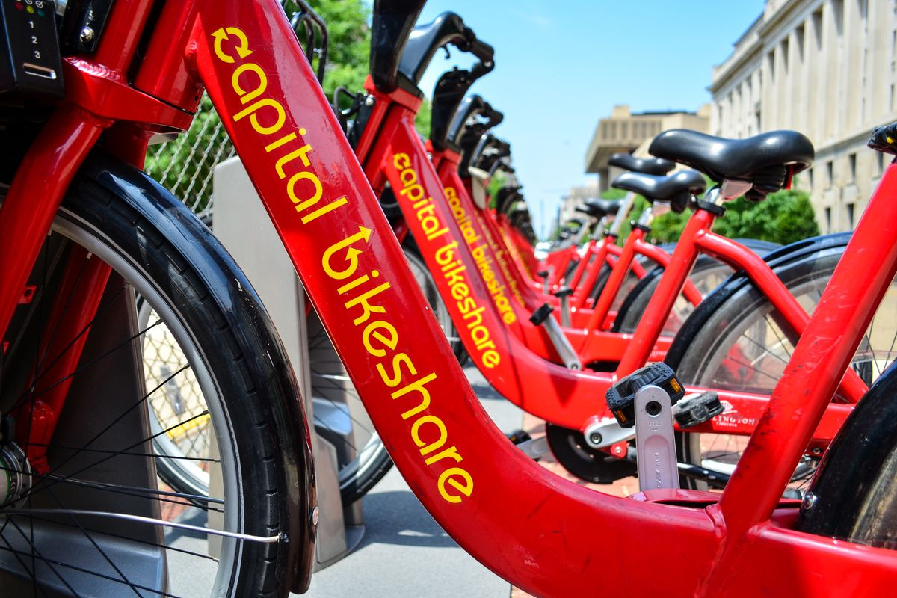
Capital Bike Share Profit Prediction
Section 101B Team 05:
Chuyou Chen, Sidney Pepple, Meng Ru, Vivian Wang, Yiqing Wang, Junyi Zhang, Xinyi Zhou

Slide 2
Agenda
Deployment
Business Understanding
Data Understanding
Unsupervised Learning
Supervised Learning

Slide 3
01
Business Understanding

Slide 4

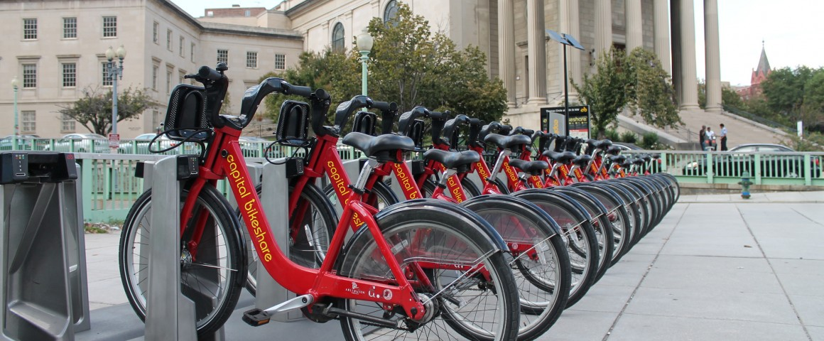
1.1 Research Background
Bike share is a unique industry
Expected growth of 3% in 8 years
Business
Understanding
Data
Understanding
Unsupervised
Learning
Supervised
Learning
Deployment

Slide 5
1.2 Business Value
Bike Sharing:
· A new way to travel
· Change people's travel habits into a more environmentally friendly way
However....
high initial capital expenditure and ongoing depreciation expense......
Big problem: how to optimize allocation efficiency to gain profits?
Our research:
Demand Prediction + Supply Optimization => Maximize Profit
Business
Understanding
Data
Understanding
Unsupervised
Learning
Supervised
Learning
Deployment

Slide 6
02
Data Understanding

Slide 7
Data Source
Bike share trip data: 2018 Jan - 2021 August, from Capital Bikeshare
Weather information: Open Weather Map
Holiday schedule: DC.gov
Potential Bias: underestimated demand
Business
Understanding
Data
Understanding
Unsupervised
Learning
Supervised
Learning
Deployment

Slide 8
Data Preparation
Missing Values: rain_1h, snow_1h
Dummy variables: rain, snow
Change data type:
Datetime → Year, Month, and Hour
Category (holiday, working day) → Numerical
Business
Understanding
Data
Understanding
Unsupervised
Learning
Supervised
Learning
Deployment

Slide 9
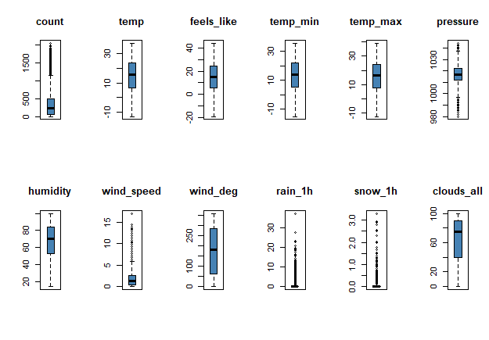
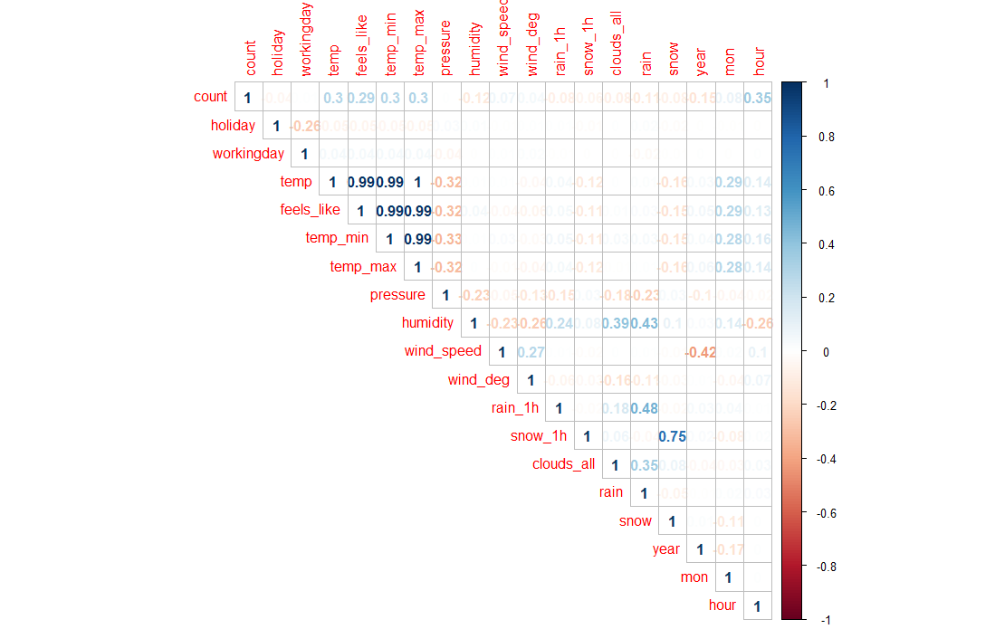
Data Visualizations
Distributions of numeric variables - outliers
Correlation Matrix
Business
Understanding
Data
Understanding
Unsupervised
Learning
Supervised
Learning
Deployment

Slide 10
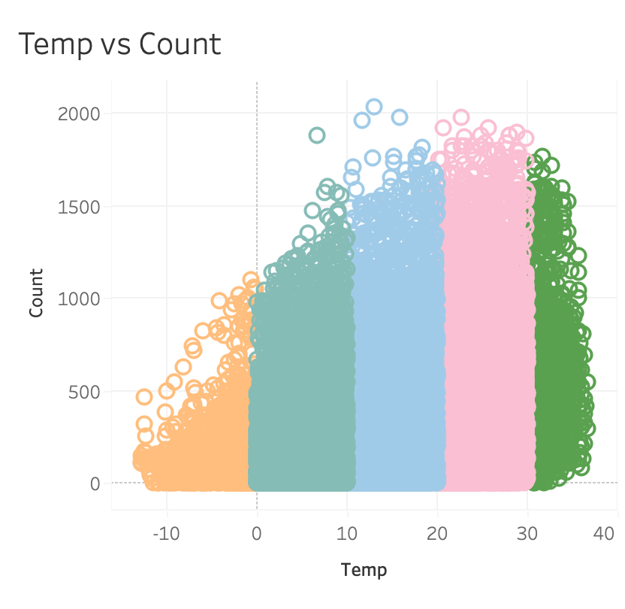
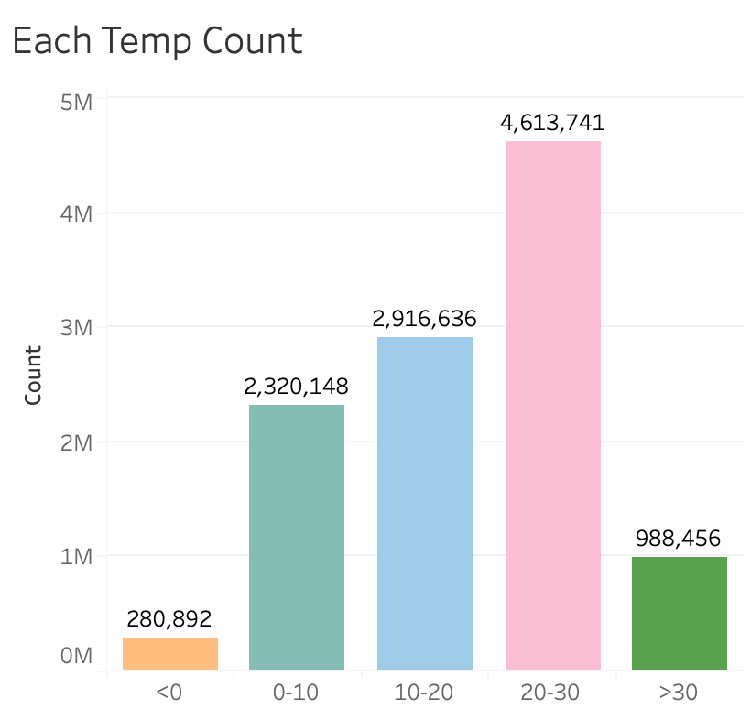
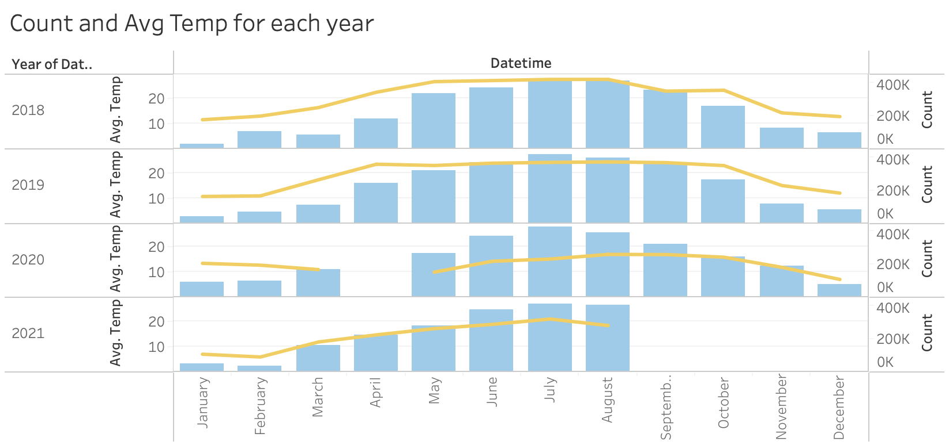
Temperature and Total Demand
Business
Understanding
Data
Understanding
Unsupervised
Learning
Supervised
Learning
Deployment

Slide 11
03
Unsupervised Learning

Slide 12




Identify the Critical Variables
To assume that the Conditional Independence Assumption (CIA) holds, by using double selection approach, we figure out that most of the variables could affect the 'count' variable significantly, suggesting that the variables chosen are meaningful.
Business
Understanding
Data
Understanding
Unsupervised
Learning
Supervised
Learning
Deployment

Slide 13
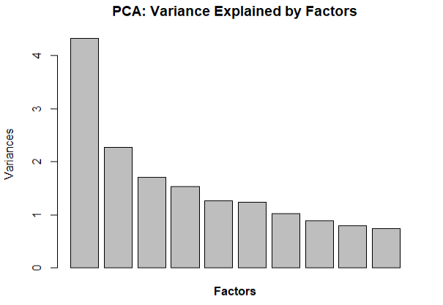
Increasing Interpretability : PCA
The first four factors can explain most of the variance in the dataset.
Higher absolute correlation helps depict each PC.
Variable | PC1 | PC2 | PC3 | PC4 | Variable | PC1 | PC2 | PC3 | PC4
holiday | -0.03 | -0.02 | 0.08 | -0.02 | wind_deg | -0.02 | 0.24 | 0.05 | 0.30
workingday | 0.03 | 0.02 | -0.05 | 0.02 | rain_1h | 0.05 | -0.36 | 0.17 | 0.16
temp | 0.47 | 0.05 | -0.08 | 0.00 | snow_1h | -0.10 | -0.13 | -0.65 | 0.17
feels_like | 0.47 | 0.03 | -0.09 | -0.03 | clouds_all | 0.02 | -0.41 | 0.02 | 0.16
temp_min | 0.47 | 0.04 | -0.08 | 0.02 | rain | 0.04 | -0.48 | 0.22 | 0.18
temp_max | 0.47 | 0.05 | -0.09 | -0.02 | snow | -0.12 | -0.14 | -0.64 | 0.18
pressure | -0.20 | 0.21 | -0.02 | -0.14 | year | 0.02 | -0.07 | -0.14 | -0.51
humidity | 0.03 | -0.52 | 0.02 | -0.08 | mon | 0.17 | -0.01 | 0.09 | 0.07
wind_speed | 0.00 | 0.17 | 0.12 | 0.65 | hour | 0.08 | 0.12 | -0.06 | 0.22
Business
Understanding
Data
Understanding
Unsupervised
Learning
Supervised
Learning
Deployment

Slide 14
PCA Interpretation by Demand Category
We use quantile to divide the 'count' variable into four categories.
The PCA table is further explored by the 'count' group.
It shows that shared bike is usually popular at hot and dry times.
Category | PC1 | PC2 | PC3 | PC4
1 | -0.65 | -0.39 | 0.00 | -0.24
2 | -0.39 | -0.16 | 0.07 | 0.08
3 | 0.11 | 0.07 | 0.01 | -0.03
4 | 0.93 | 0.48 | -0.09 | 0.19
Business
Understanding
Data
Understanding
Unsupervised
Learning
Supervised
Learning
Deployment

Slide 15
04
Supervised Learning

Slide 16
Target: Predict Quantity Demand for Bikes
Given weather, date and time, how many bikes are going to be demanded within one hour?
Model | Out-of-sample R2
Linear Regression | 63.05%
Linear Regression with Interaction with Working Day | 73.89%
Lasso Estimates | 73.84%
Post Lasso Estimates | 73.89%
Ridge | 73.84%
Regression Tree | 60.92%
Random Forest | 86.69%
Business
Understanding
Data
Understanding
Unsupervised
Learning
Supervised
Learning
Deployment

Slide 17
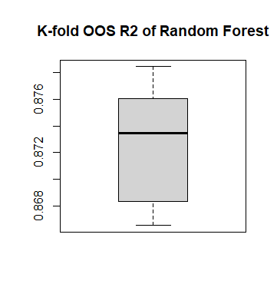
Random Forest has Stable Performance in K-fold
Min. | 86.65%
1st Qu. | 86.84%
Median | 87.35%
Mean | 87.25%
3rd Qu. | 87.56%
Max. | 87.85%
Business
Understanding
Data
Understanding
Unsupervised
Learning
Supervised
Learning
Deployment

Slide 18
Determine the Appropriate Supply Level
p= Price per trip ($1)
c = Operating cost to supply one bike ($0.28)
s= Number of bikes supplied
d = Number of bikes demanded
E[Profit] = E[Revenue] - E[Cost]
= E[p * min(s, d)] - c * s
= p * E[min(s, d)] - c * s
= p * [s * P(s < d) + d * P(d < s)] - c * s
Business
Understanding
Data
Understanding
Unsupervised
Learning
Supervised
Learning
Deployment

Slide 19
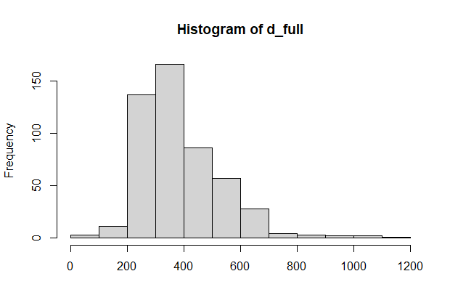

Determine the Appropriate Supply Level
E[Profit] = p * [s * P(s < d) + d * P(d < s)] - c * s
s
P(s < d)
Try different supply levels
Based on data from Oct 7, 2021 18:00
Business
Understanding
Data
Understanding
Unsupervised
Learning
Supervised
Learning
Deployment

Slide 20
05
Deployment

Slide 21
Supply at the Optimal Level
Potential Issues
Other Considerations
Scope Limitation
Business
Understanding
Data
Understanding
Unsupervised
Learning
Supervised
Learning
Deployment

Slide 22
Thanks!
]]

Slide 23
Sources and References
Bike and scooter rental market. Market Research Firm. (n.d.). Retrieved October 5, 2021, from https://www.marketsandmarkets.com/Market-Reports/bike-scooter-rental-market 122654882.html.
Bike Share Data: http://capitalbikeshare.com/system-data
Weather Information: https://openweathermap.org/history
Holiday Schedule:
https://dchr.dc.gov/page/holiday-schedules-2018
https://dchr.sp.dc.gov/policy/PCA/EDPM/Issuances/Public%20Holidays%202019.pdf
https://edpm.dc.gov/issuances/legal-public-holidays-2020/
https://dchr.dc.gov/page/holiday-schedules
Capital Bikeshare Pricing: https://www.capitalbikeshare.com/pricing
Arlington Operating Cost: https://www.bikearlington.com/wp-content/uploads/2020/02/FY19-Summary-Report-on-Capital-Bikeshare-FINAL.pdf

